Slide 1
CS 0447 Recitation 5

Slide 2
Last Week’s Quiz
Q1
A: 10987654321 – The code loops as long as s0 is greater than 0 and prints the value in s0. This value is initialized to 10. The answer is not one long number – there just are no spaces/newlines printed
Q2
A: To store the address of the next instruction to execute – The PC register tells the CPU what it should be executing
Notes:
Q1 – Read some loop code. Basically, a for loop from 10 to 1 where i is printed.
Q2 – What does the PC register do in MIPS

Slide 3
Last Week’s Quiz
Q3
A: Conventionally, you should be passing a0 and a1 into the function, not s0 and s1; The contents of t0 are unknown after calling jal. You should use s0 instead for the loop counter
Remember calling conventions – arguments go in a registers and t registers are not preserved
Q4
A: if (t0 == 10 && t1 == 25) { // do stuff }
In Java, we enter the if block if the condition is true. In this case, we have an AND statement, so both clauses need to be true. The MIPS code has applied DeMorgan’s Law, and will skip over the if when either clause is false.
Notes:
Q3 – What is wrong with this code?
Q4 – What is the Java equivalent to this MIPS code

Slide 4
This Week’s Quiz
As usual, you have 5 minutes to work on this week’s quiz

Slide 5
Project 1
Important!!! Meet with me by Friday the 15th to discuss your plans for the project!!!!
I don’t expect you to have it entirely planned out, but show up with ideas for things like functions and data structures to implement, handling invalid input, etc
Each meeting should take 5-10 minutes at most
I’ll hang out for a little while after recitation, or you can come to my office hours
You need to do this or you will lose points!!
Don’t throw away what is essentially 10 free points

Slide 6
Project 1
Your goal for this project is to implement a reverse-polish notation calculator
This basically means operators come after the numbers
There are examples in the project description
The calculator is based on a stack data structure
The stack has a capacity of 4, and each entry on the stack stores a number being used by the calculator
Cell | Value
R3 | 1
R2 | 1
R1 | 1
R0 | 1

Slide 7
Project 1
When the user inputs a number, it is written into R0
There are some special cases here that I will mention later
When the user presses enter, the number stored in R0 is duplicated and stored in R1
This can be thought of as a push – the numbers in R1 and R2 move down, and the number in R3 is discarded
R3 | 3
R2 | 2
R1 | 1
R0 | 8
R3 | 2
R2 | 1
R1 | 8
R0 | 8
Press Enter

Slide 8
Project 1
When the user enters an operator, it is applied to the values in R1 and R0, and the result is written to R0
R1 is on the left for this – keep that in mind for subtraction and division
The user entering an operation effects the next action – if they input a number next, R0 must be duplicated as if they hit enter
When an operator is entered, the values in R1 and R0 are removed
R0 is replaced by the result of the operation
R1 is replaced by what was previously in R2 – the values move up
The value in R3 is copied to R2, and R3 is set to a copy of itself

Slide 9
Project 1 Tips/Advice
Start early!
Trust me: your life will be less stressful the earlier you start assignments
Write functions to things your program will need to repeatedly do
Ie: respond to an enter press, respond to an operator being input, displaying the calculator, etc
Break the project into smaller, more manageable bits – the project description suggests one way of doing so
Test things as you implement them!

Slide 10
Project 1 Tips/Advice
Read the project description carefully – it lays out how the calculator should work, and everything that your program needs to do
If you have questions, ask! Don’t struggle in silence

Slide 11
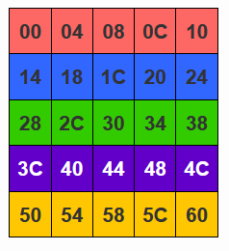
Matrices
A matrix is just an array where each element is another array
This creates a grid shape with rows and columns
Don’t stress about matrices! They’re just arrays, except with other arrays as elements

Slide 12
Calculating Offsets in Matrices
Remember the formula we used for normal arrays
Address = A + (i * b)
Let’s extend this to work with matrices
Begin by figuring out how to calculate the address of a row
We have the base address A of the matrix
i is just the index for the row we want
Now we need the size of each row to plug in for b
In our example, we have 5 elements that are 4 bytes in size, so 5 * 4 = 20
Now we know how to get the address for a row!

Slide 13
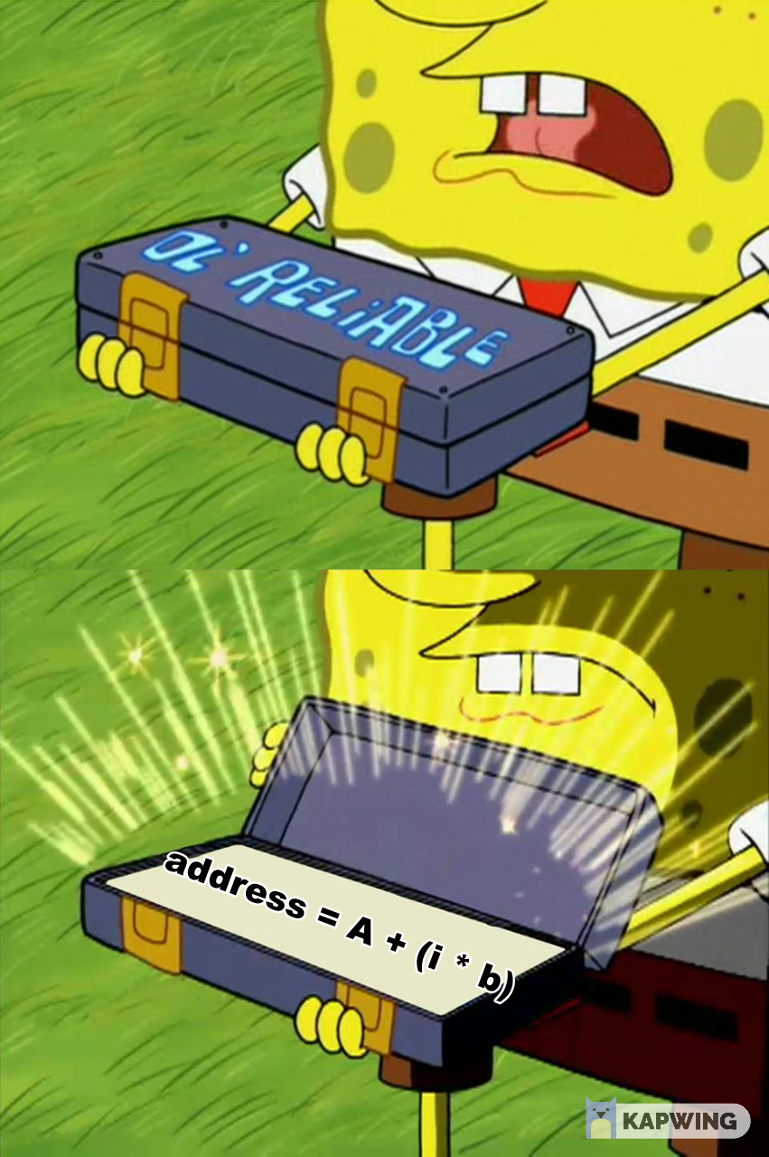
Calculating Offsets in Matrices
To get the address of a cell within a row, we go back to ol’ reliable: address = A + (i * b)
Except now A is the address of the row
We can put everything together and get a formula for calculating the address of a cell in our matrix
address(i, j) = matrix_addr + (i * 20) + (j * 4)
Of course, if the cells or rows were different sizes, we would not use 20 and 4 specifically
To generalize, 20 would be replaced by (row length * cell size) and 4 would be replaced by cell size

Slide 14
Summing up Matrices
A matrix is just an array of arrays, which forms a 2-dimensional grid shape
They are useful for representing various ideas when programming
We can calculate the address of a cell in a matrix using an extended version of the same formula we use for normal arrays

Slide 15
Lab 5 Part A
DO NOT MODIFY HOW THE FUNCTION CALCULATES THE PRODUCT!!
The only thing wrong with the function is that it does not follow calling conventions!
Your job is to fix it so that it does
Remember: arguments go in a registers, and return values go in v registers
Notes:
Need to make a function follow calling conventions

Slide 16
Lab 5 Part B
B.1 – Follow along with the lab description and fill out the table – use breakpoints to pause your program and look at the data segment to look at mem[sp]
B.2 – Remember our discussions about how pushing/popping really works
To push: subtract from sp and store a word
To pop: Load from sp, then add to sp
B.3 – All you need to do is translate the C code into MIPS – please don’t try to actually solve the Towers of Hanoi problem
Notes:
Fill out table, implement push/pop, write print statements & make recursive calls

Slide 17
Lab 5 Part C
We talked about matrices today – you know the necessary formulas to calculate the address of array and matrix entries
You can implement C.1 and C.2 using these formulas
C.3 and C.4 just involve calling the functions you wrote for C.1 and C.2
You’ll want to use loops here
Notes:
Calculate addresses, print array/matrix

